Slide 1
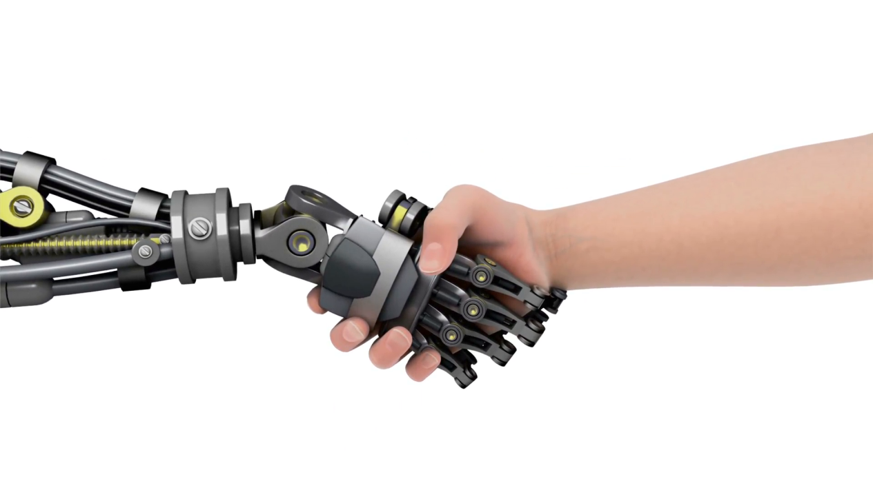
MTC-Intelligent Automation Meeting 27-06-2018 Future Challenges in Human-Robot Collaboration

Slide 2
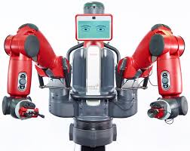
Industry 4.0: Fact or Fiction?
There is a lot of hype about collaborative robots in the media which report that some businesses are investing heavily in ‘Cobots’ as part of a shift towards the next industrial revolution. But are all areas of industry ready for such a revolution?
Are Cobots up to the challenge of delivering ROI for industries that have previously leveraged on the skill of human workers?

Slide 3
Problem Definition
Robot programming can be difficult and slow, particularly as tasks become more complex. As task complexity increases so too does the need for additional sensors which require integration adding yet more complexity.
What can be done to help speed up this complex systems integration and robot programming?

Slide 4
Agenda
9:45 Brain Writing, What Are Robots Bad At?
10:00 Complexity v Impact, Analysis
10:20 Coffee
10:30 Barriers, Limitation & Solutions
12:30 Finish for Lunch

Slide 5
Current Industrial Robotics
What are Robots Good At?
Rhetorical Question
W.R.T Industry Needs: What are Robots Bad At?

Slide 6
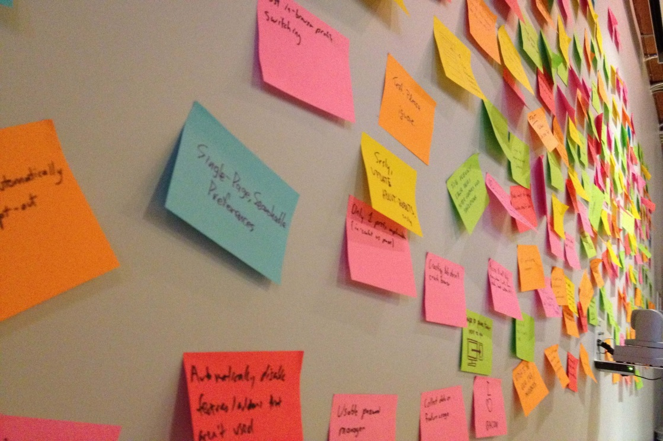
Brain Write
W.R.T Industry Needs: What are Robots Bad At?

Slide 7
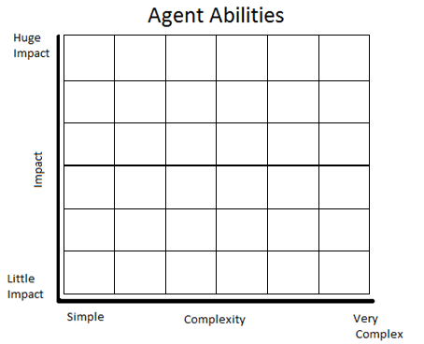
Complexity v Impact, Analysis

Slide 8

Coffee Time

Slide 9

Limitations?
What is limiting this technology from being adopted more widely or to its full potential?
Barriers?
What is preventing this technology from entering the industrial automation market?

Slide 10

Innovation?
Which promising proof-of-concept results should be further developed for industrial uptake?
Research?
What fundamental research questions should be answered to achieve the next breakthrough ?

Slide 11
Thank You

